Slide 1


L8: Natural Language Processing
Digital Health
UCSD Extension – Specialization Certificate
Data Science for Digital Health
Hobson Lane, UC San Diego
Instructor

Slide 2
What is NLP (Natural Language Processing)?
How can it be used in healthcare?

Slide 3
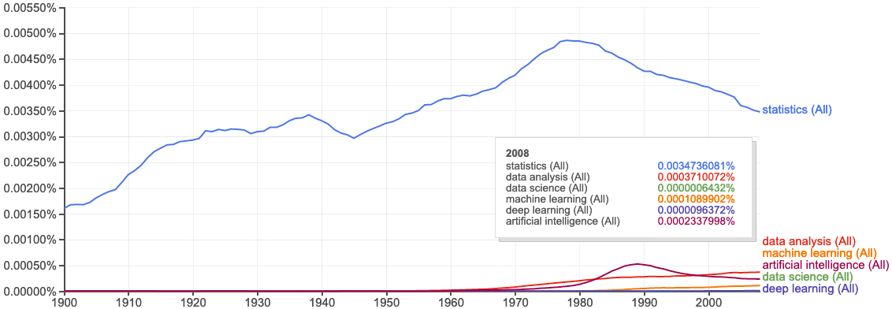
Terminology Progression
books.google.com/ngrams

Slide 4
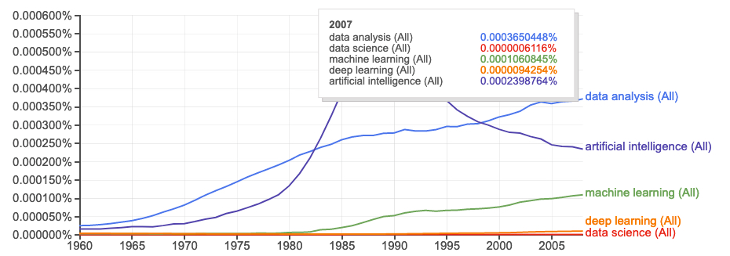
Data Science on “data science”
Peter Naur
“datalogy”
“data science”
books.google.com/ngrams

Slide 5
What is a Language Model?
Your blood pressure is too .
How old are ?
Does it hurt when you ?
Do you have a family history of ?
Dr. told me the diagnosis .
Patient LDL level is 100, level is 50, and the total is .
Dr. Smith gave me best estimate .

Slide 6
What is a Language Model?
Your blood pressure is too .
How old are ?
Does it hurt when you ?
Do you have a family history of ?
Dr. told me the diagnosis .
Patient LDL level is 100, level is 50, and the total is .
Dr. Smith gave me her best estimate .

Slide 7
NLP in medicine
Clinical medical record summarization
Diagnosis based on clinical medical records
Information extraction from research articles
Document classification
Nurse bots and apps (unregulated markets like Africa)
Therapy bots (Woebot)
Genome sequencing

Slide 8

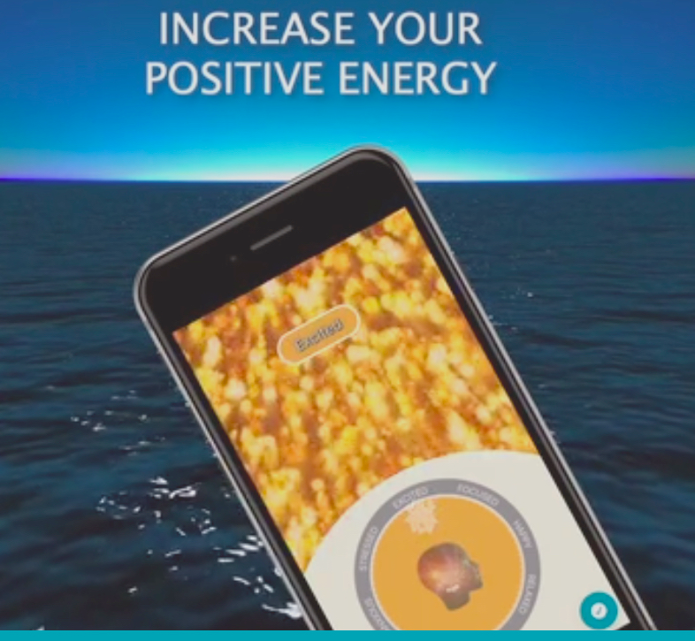
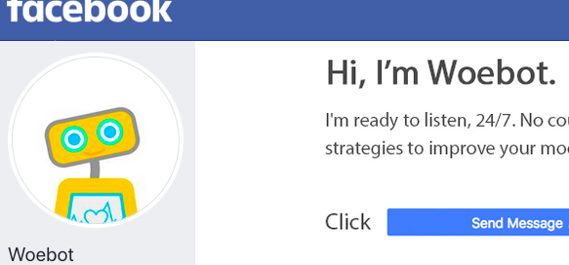
Emotional first aid
MindCurrent.io
Mindfulness coaching apps
Meditation apps: Calm, Breath
Fitness tracking and journaling
Video game and twitch “defuser” bots
Social media curation bots
Depression counseling (Woebot)

Slide 9
Disability assistance
Aira.io
Visual interpreter for the blind
Meditation apps: Calm, Breath
Fitness tracking and journaling
Video game and twitch “defuser” bots
Social media curation bots
Depression counseling (Woebot)

Slide 10
Bayesean Filter (Spam Filter)
Updated Probability = Likelihood Ratio x Prior Probability

Slide 11
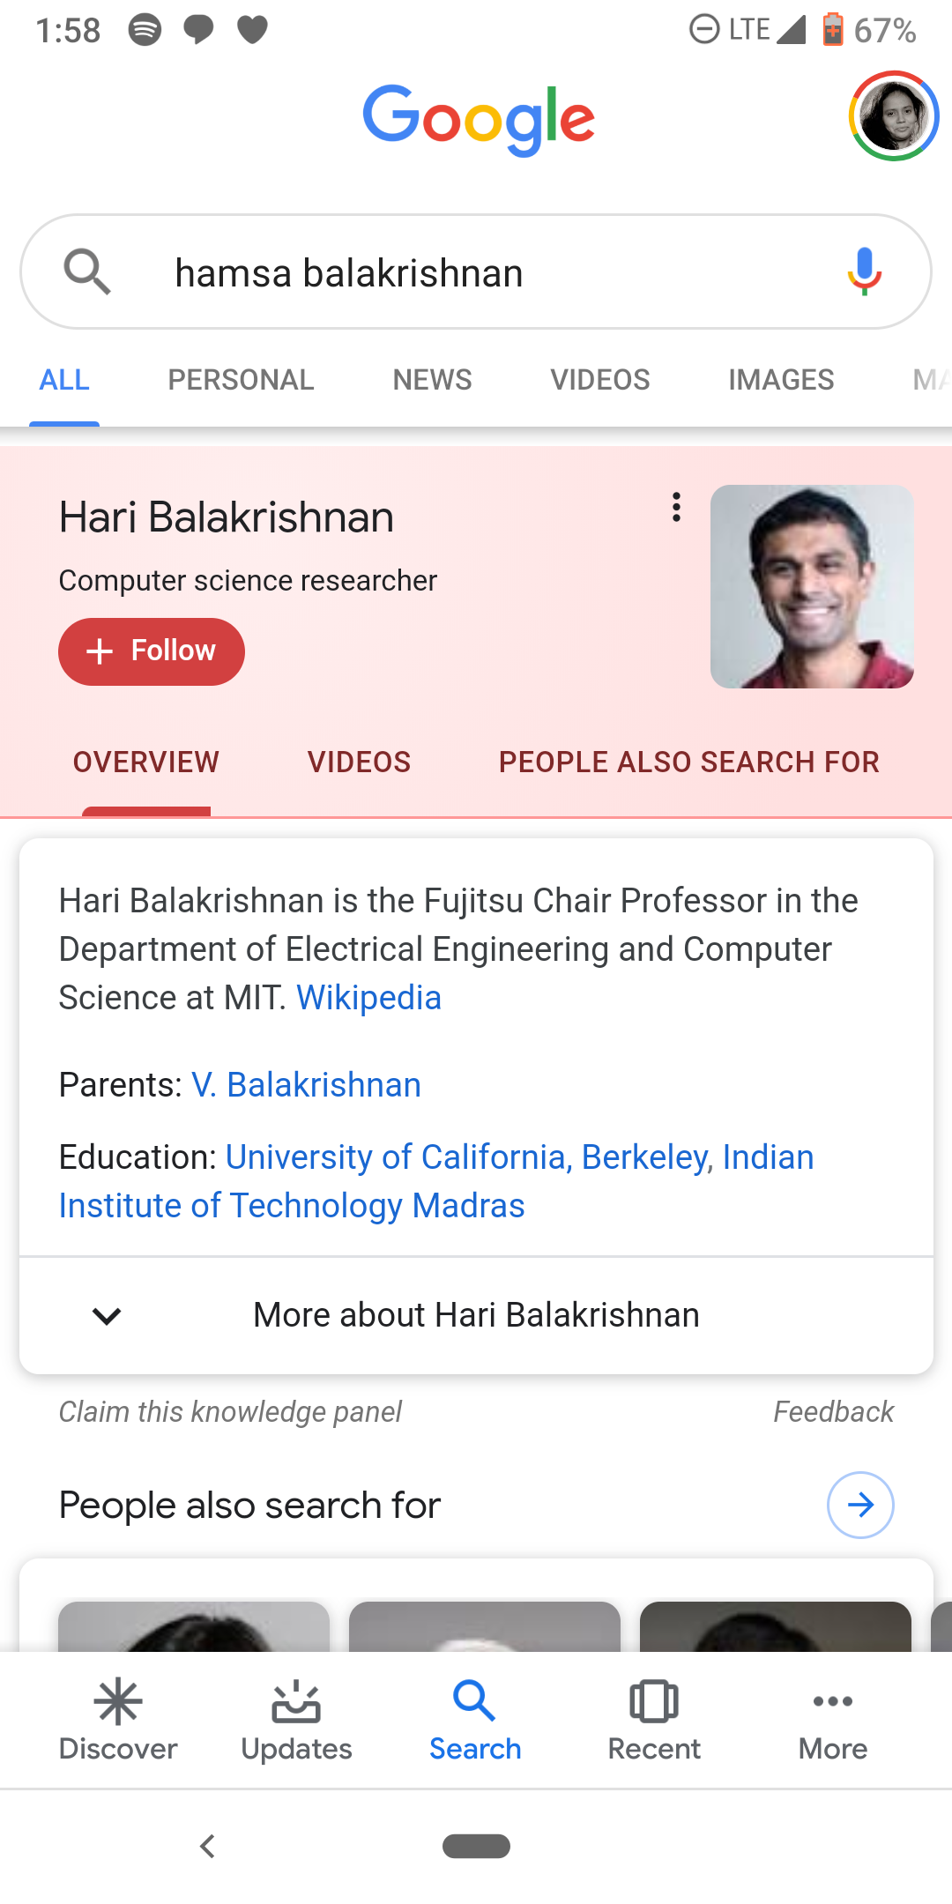
Gender Bias
Hamsa is a female CS researcher
Hari is her brother
Their parents are both famous

Slide 12
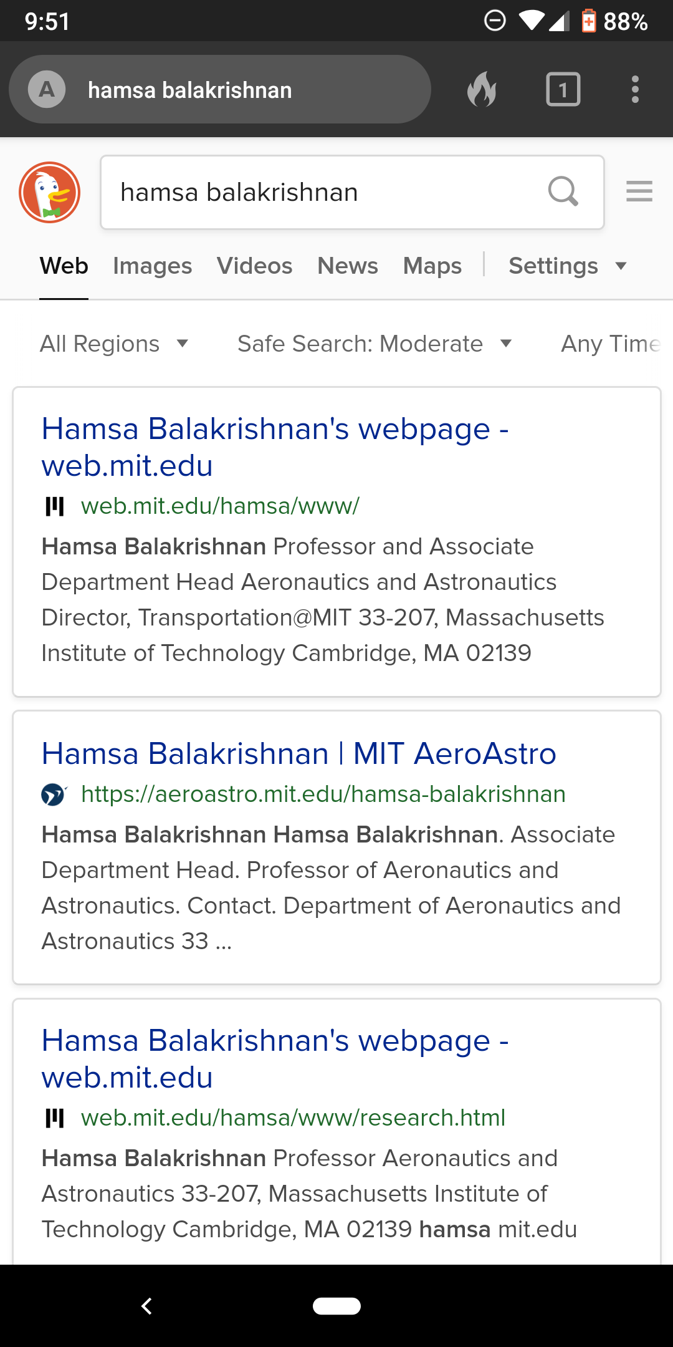
Duck the Bias!

Slide 13
Assignments

Slide 14
Quiz
How much femaleness is in the word “nurse”? “doctor”?

Slide 15
Quiz
Can a whistle be used for natural language communication? What about machine language?
What is a language model?
Why aren’t there language models for machine language (software code)?

Slide 16
Homework: Create diabetes MLE

Slide 17
Homework: Create diabetes MLE
How much “woman”ness is in the Word2vec vector for “nurse”? “doctor”? “surgeon”? “radiologist”? “patient”?
What does your answer to Q1 mean about medicine and doctors?
Name 3 applications of NLP to medicine and digital health.

